Slide 2



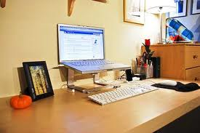
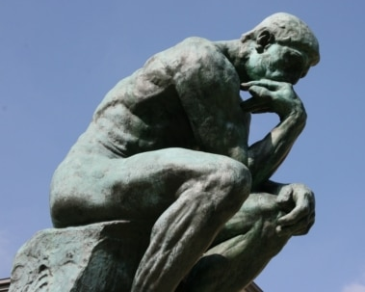



Good Habits
Cleanliness
Punctuality
Neatness
Organization
Careful in Thought
Reliable
Studious of Bible
Slow to Speak
X
X
X
X
X
X
X
X

Slide 3
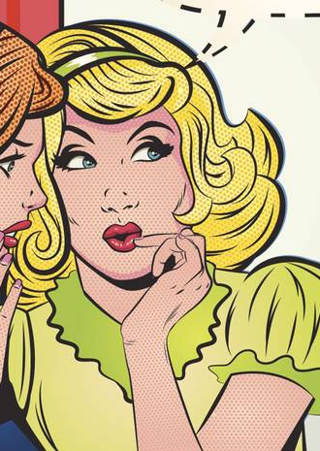

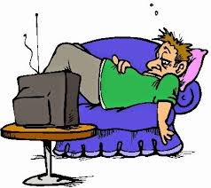
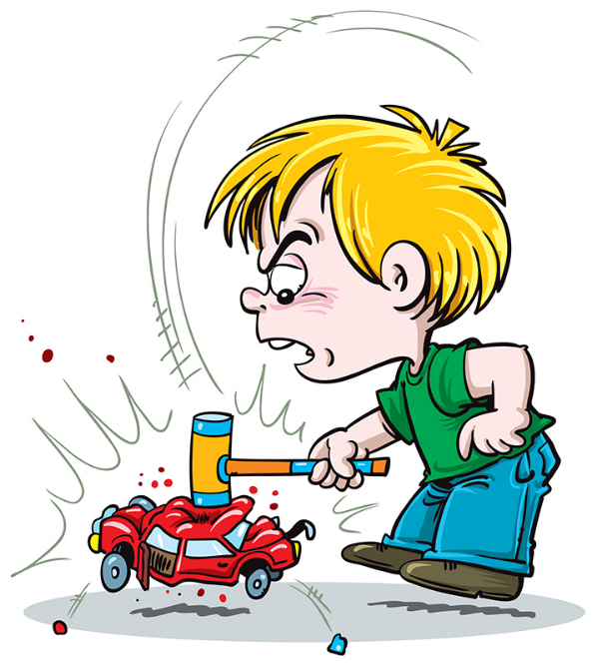
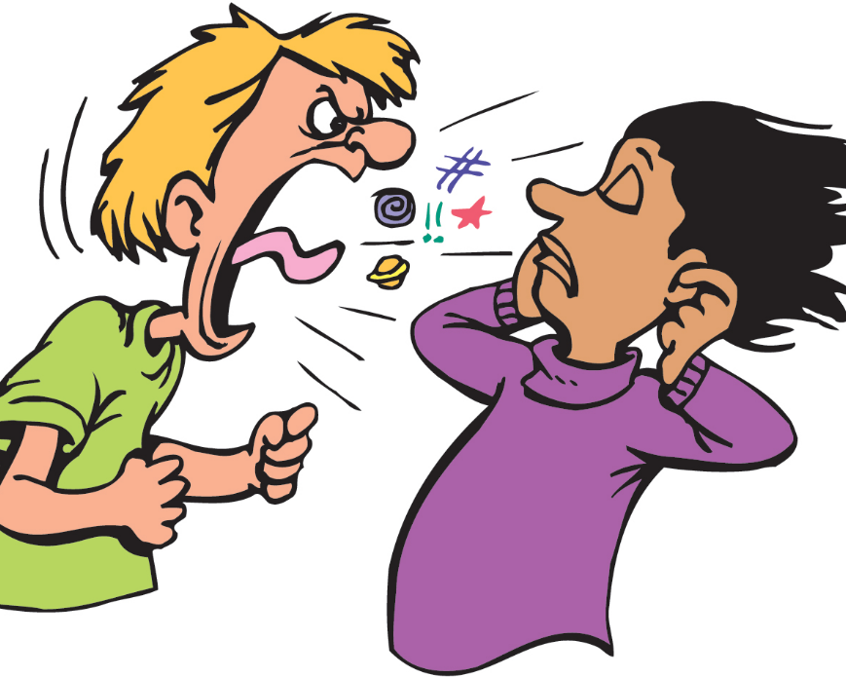

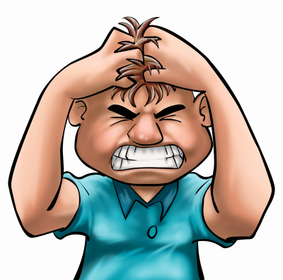
Bad Habits
Careless Speech
Laziness
Procrastination
Rebellious Conduct
Profanity
Neglect Responsibilities
Quickness to Anger
X
X
X
X
X
X
X

Slide 4
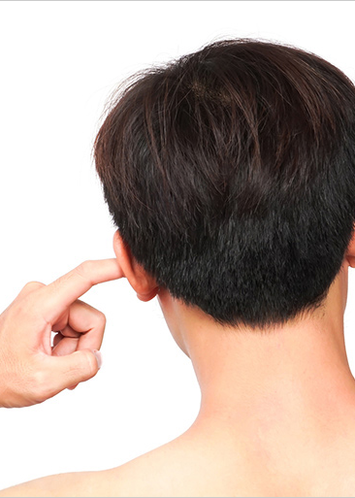
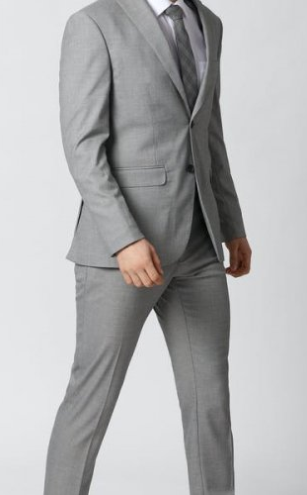

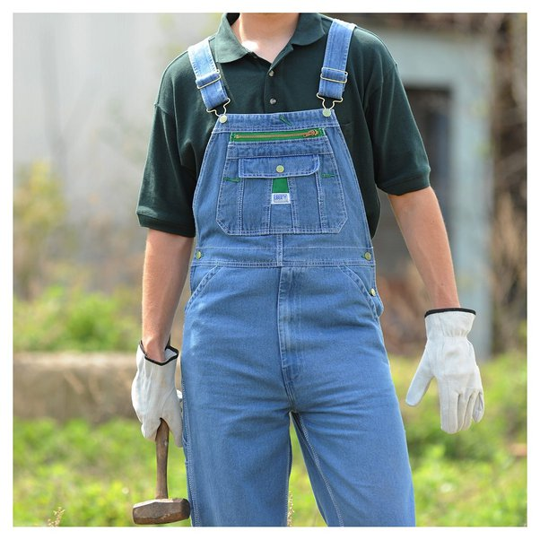
Indifferent Habits
Scratch left eat when he is thinking
Way a person walks or talks
Wearing overalls instead of fancier clothes
X
X
X

Slide 5
USE GOOD JUDGMENT
CULTIVATE
MODIFY
ELIMINATE

Slide 6
I Can’t Serve God & Have A Habit of Profane Language
Ephesians 5:3,4 “ neither filthiness, nor foolish talking, nor coarse jesting, which are not fitting”
I Can’t Serve God Without A Habit of Spiritual Growth
2 Peter 1:5-10 “giving all diligence”

Slide 7
Some Habits May Hinder My Influence On Others
Ask These Questions:
IS this a habit I want my children to have just like me?
DO people think well of this habit when they see me have it?
Does this habit bring glory to God?
IF Christ were on earth today, would He join with me in this habit, or disdain what I am doing?
IF everybody had this habit, would the church be made weaker or stronger for it?

Slide 8
How Should We View The Habits of Others?
Sin must be rebuked and corrected – Ephesians 5:11
Indifferent habits should always be met with tolerance and love
Good habits ought to be encouraged, praised & emulated
Some Habits May Appear “Indifferent” to some, may be “bad” to others
Here is where the judgment comes in – Matthew 7:1-5
IF I think it’s bad, for me it’s bad – Romans 14:4,10
1 Corinthians 8:13

Slide 9
When The Truth Is Challenged Or Ignored-
We Know We Should Defend God’s Truth
Jude 3 “contend earnestly for the faith which was once for all delivered to the saints.”
Acts 15:1; Galatians 2:3 No Small Dispute!
We Know What Our Proper Motivation Should Be
NOT for: A Love For Argument – Galatians 5:14,15
NOT for: A Desire for Personal Victory – “See, I was right!”
NOT for: A Party Spirit – Ours better than yours!

Slide 10
We Know What Our Proper Motivation Should Be
It Is Because of:
Knowledge that without the truth people will be lost
An overwhelming goodwill toward them – they NEED the TRUTH OF GOD for their salvation
2 Timothy 2:24-26 – they are the DEVIL’S CAPTIVES!
Our Conduct Therefore:
We will be firm & sure, not dogmatic & overbearing
We will be aggressive with the truth, not mean spirited

Slide 11
SUCCEED OR FAIL, WE MUST NEVER ALLOW OURSELVES TO TAKE IT PERSONALLY
1 Corinthians 3:6 “I planted, Apollos watered, but God gave the increase.”
May be despised even when we have done right
Matthew 5:11,12 “say all kinds of evil against you falsely for My sake.”
1 Kings 19:1-4; Jeremiah 36:27-32; Matthew 11:2-6; Luke 23:34; Acts 5:40-42; 16:25; Hebrews 10:32-34

Slide 12
What About When We Face The Hard Trials of Life?
    Christians are not immune to such problems -
    Philippians 2:25-30 – we get sick
    Acts 8:2 – Still lose loved ones
    Hebrews 10:34 – Lose possessions
    Revelation 2:13 – Antipas was killed
    2 Corinthians 11:23-25 – Paul beaten repeatedly
    1 Peter 5:6,7 – cast care on Him
    1 Corinthians 10:13 – a way of escape
    2 Peter 3:9 – He keeps his promises

Slide 13
What About When We Face The Hard Trials of Life?
    Psalm 118:8,9 – Trust in God
    Hebrews 13:5,6 – Must not fear man
    James 1:2-4 – Rejoice in adversity
    Romans 8:35-39–Nothing can separate from Christ’s love
    2 Corinthians 4:16-5:2 – Take heart and comfort in this; we have an eternal home beyond this life

Slide 14
WHAT SHOULD YOU BE DOING RIGHT NOW?
    Not a Christian – Obey the Gospel NOW!
    Not living as you should as a Christian, you need to REPENT and ask God for forgiveness
    IF you are serving Him, do so faithfully-
    Colossians 1:9-10 NKJV 9 For this reason we also, since the day we heard it, do not cease to pray for you, and to ask that you may be filled with the knowledge of His will in all wisdom and spiritual understanding; 10 that you may walk worthy of the Lord, fully pleasing Him, being fruitful in every good work and increasing in the knowledge of God;

